Slide 1

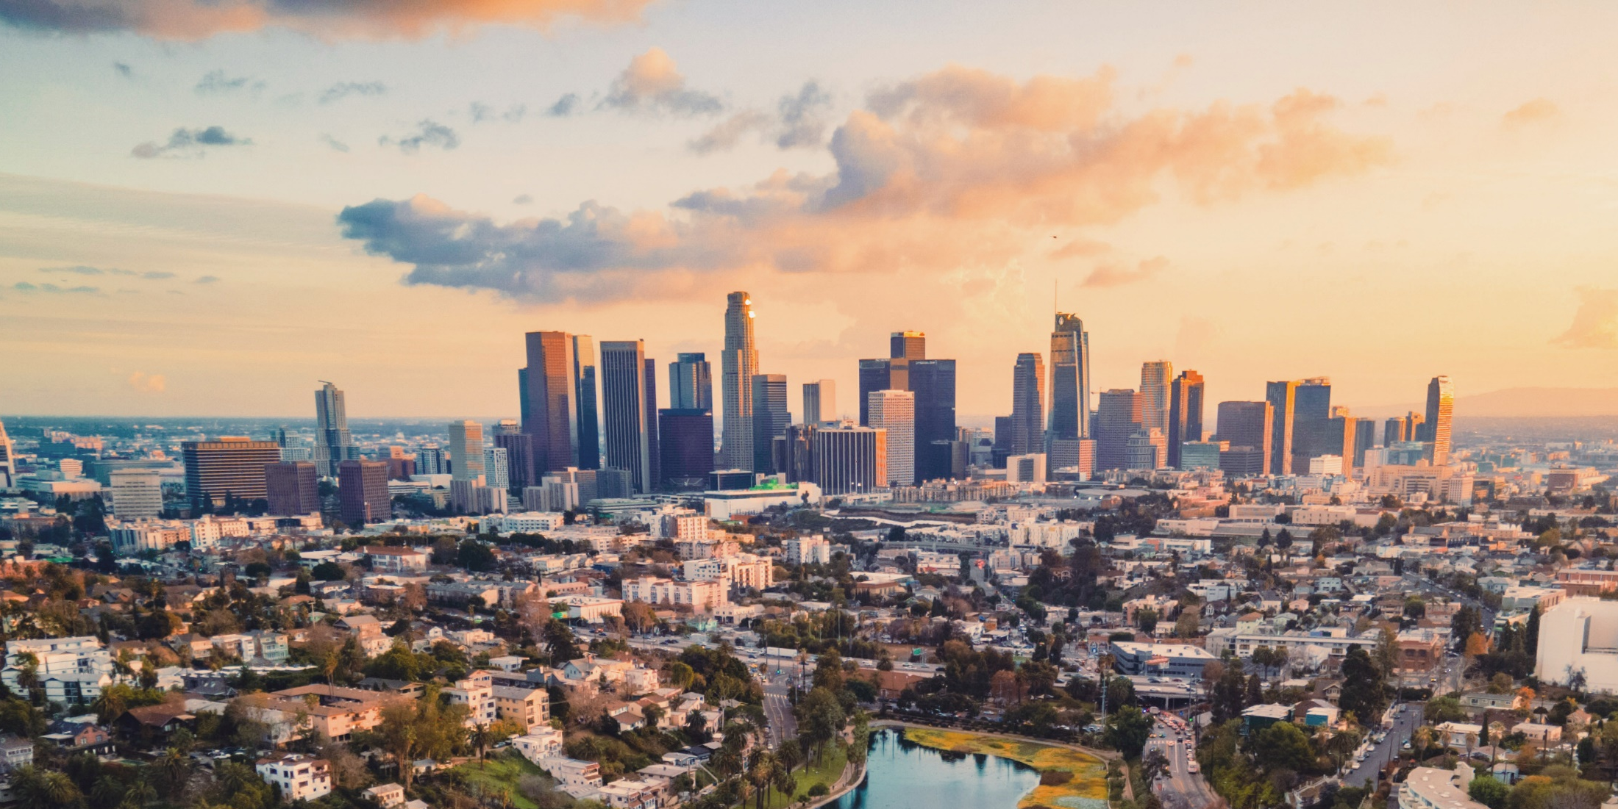


WE-R-NO-ANGELS
Team Members
Haritha Koleti
Michelle Petras
Veethika Singh
Kathleen Snider-Belinski
Carmen Wiggins
Crime statistics from the City of Los Angeles

Slide 2
Crime in the city of angels 2020 - 2024
LA is the “City of Angels”
We are exploring the darker side of it via LA crime data
Perhaps LA citizens are not as angelic as their city name suggests

Slide 3
Divine inspiration (Data Sources):
Data was downloaded from the City of Los Angeles at this URL:
https://data.lacity.org/Public-Safety/Crime-Data-from-2020-to-Present/2nrs-mtv8/about_data.
The data contains crime information accumulated from 2020 through the first few months of 2024
The crime data analyzed has approximate million records

Slide 4
Harps and halos(Tools used):
Pandas
Numpy
Matplotlib
Plotly Dash
Leaflet
Machine Learning
SCKit
Spark SQL
Tableau
Python
Jupyter Notebook
Heroku

Slide 5
Little Demons(Challenges)
Tried to get more accurate location information by utilizing zip codes, but data was not readily available without purchase because of the volume of data
Spark had problems with Plotly Dash, so Plotly Dash was implemented in Pandas DataFrames
Heroku was attempted to be used to deploy our app, but it is available only by purchase
Tableau trial period ended and a new account needed to be created, and data was often deleted instead of published

Slide 6
Spreading our wings – machine learning
The goal of this analysis is to identify patterns, trends, and factors contributing to crime in LA that would predict hotspots and understanding the factors that influence crime rates.
Crime is dirty, and so was our data. Normalizing it consisted of tuning, crime binning, cleansing, and formatting
Reaching the gates of heaven of 80% accuracy to meet St. Peter, we instead were greeted with Judas, as the initial run using logistic regression resulted in 19% accuracy on the dataset with all features included
Random Forest provided us one step closer to the pearly gates with a 35% accuracy return
We heard the celestial choir of angels when performing the same functions on selected features which dramatically increased accuracy to 89%
Checked other models to see if any could increase accuracy more than 89% to ensure our faith was not misguided

Slide 7
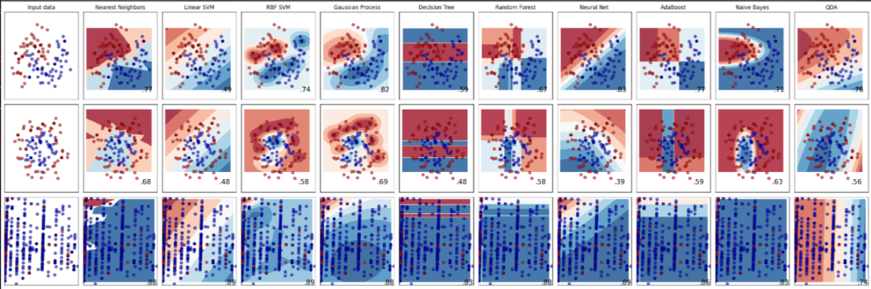
We’re snow angels
Checked other models to see if any could increase accuracy more than 89% to ensure our faith was not misguided… and HALLELUJAH!

Slide 8
The devil is in the details
During the process of fine tuning the machine models we learned that where you live matters
Additionally, being a woman between the ages of 10 – 55, you were more likely to become a victim of violent crime or theft
However, during the fine tuning process, we made note of various features that seemed to increase accuracy, even though they did not get us to the final goal of over 80%
During that process we suspected that these features may have some importance and in our granular analysis, and we chose to explore them
Some of these features include:
Crimes against children, including those under the age of 10
Lynching, which there weren’t enough data points to carry weight in our model
Females were more likely to be a victim when compared to men, but crimes against men cannot be ignored
We applied what we discovered in fine tuning the machine learning model as the basis to analyze the Los Angeles crime data

Slide 9
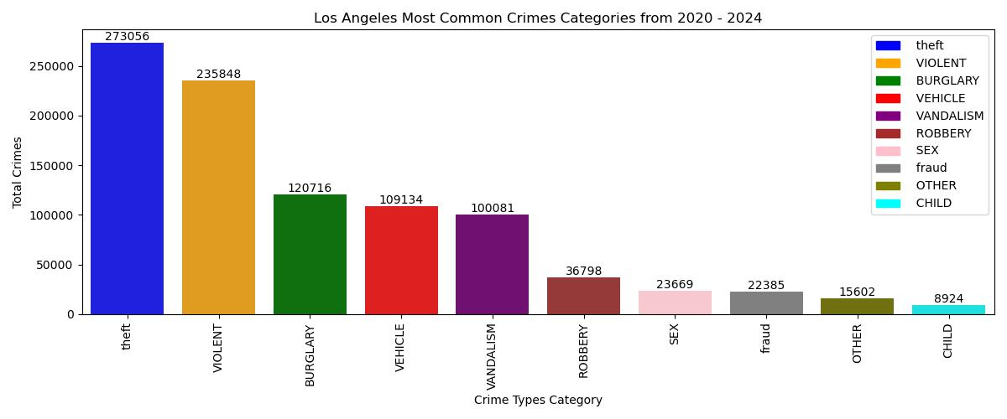
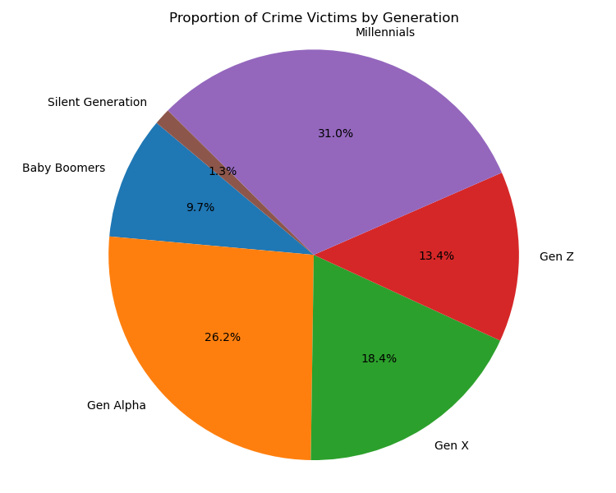
Crime Analysis
Los Angeles most common Crime per category is Theft with a total count of 273K incident between the years 2020-2024
Our data also included the ages of the victims, which helped us identify the generation most affected by crime. Millennials are the generation with the highest percentage of crime victims at 31%, followed by Gen Alpha at 26.2%
Notes:
Generation Age Ranges
Gen Alpha 0 - 11 years , Gen Z 12 - 27 years, Millennials 28 - 43 years, Gen X 44 - 59 years, Baby Boomers 60 - 78 years, Silent Generation : 79 - 96 years

Slide 10
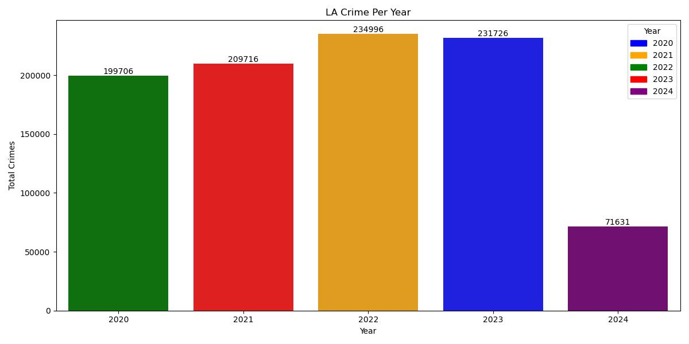
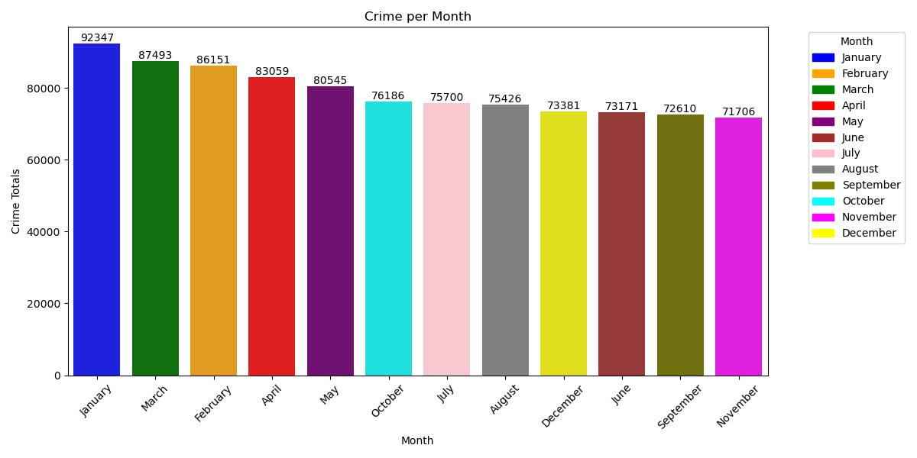
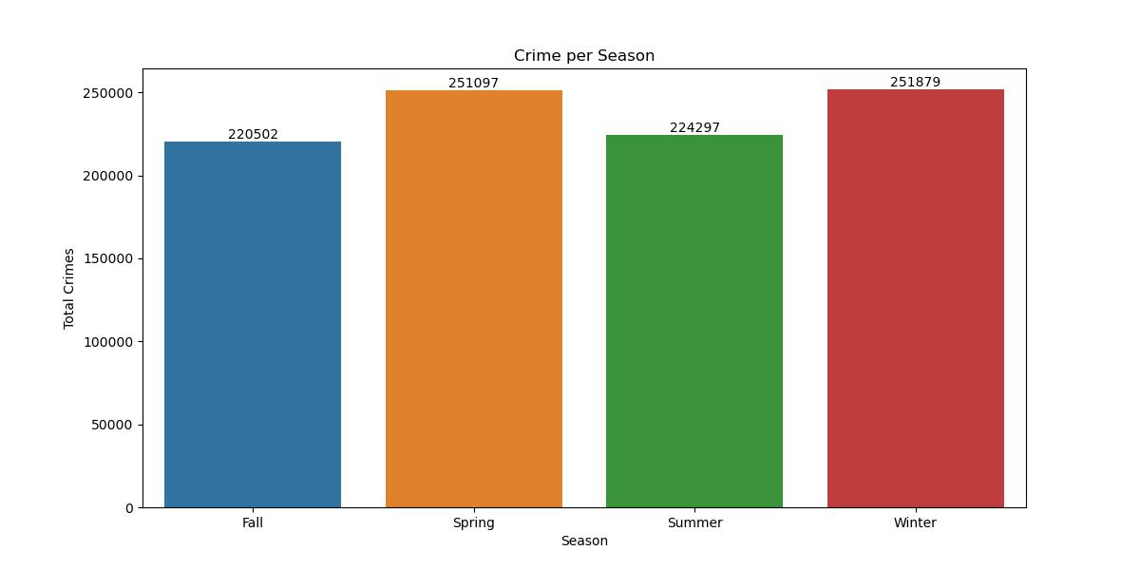
Crime over Time
Los Angeles crime data over time period 2020-2024 is represented in years, months, and seasons.
The highest crime incidents occurred in 2022 and 2023.
January consistently had the highest number of crime incidents throughout the years.
The spring and winter seasons recorded the highest crime incidents.
Notes:
* 2024 consist of 5 month of Crime Data.

Slide 11
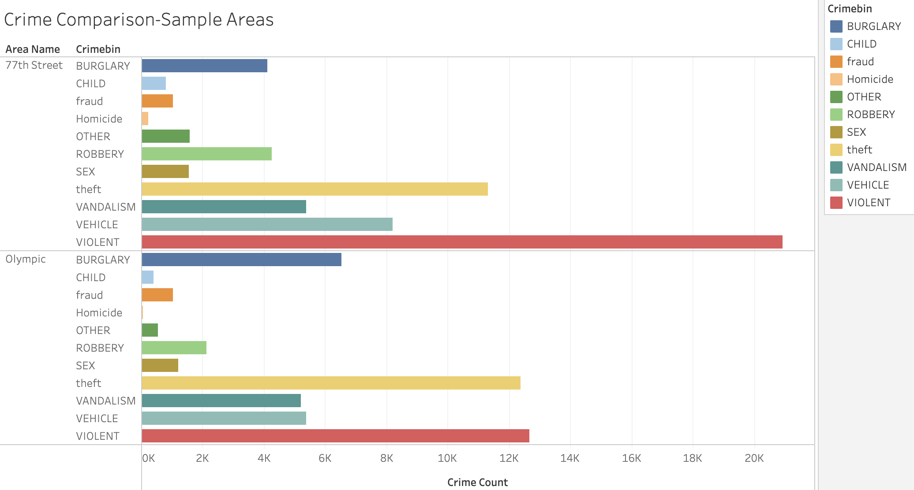
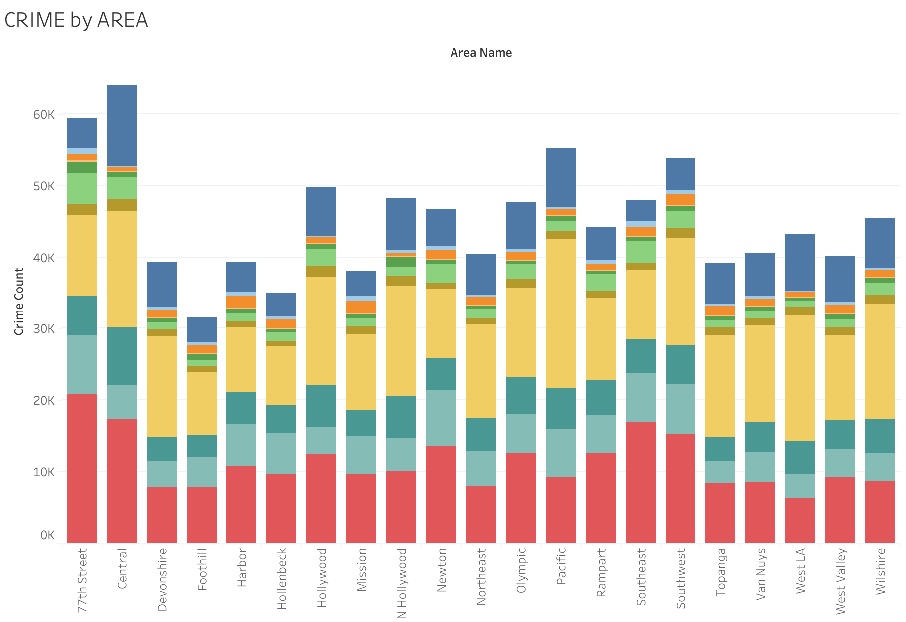
Crime per area
.
This graph represents crime in Los Angeles by area. For comparison purposes, we selected two areas where the machine learning accuracy was over 80% and population count was comparable and a disparity in income. Olympic is considered a high-income area while 77th Street is identified as a lower income demographic. The study shows that the number of thefts was more likely in the high-income area compared to the low-income area, while violent crimes were more prevalent in the low-income area.

Slide 12
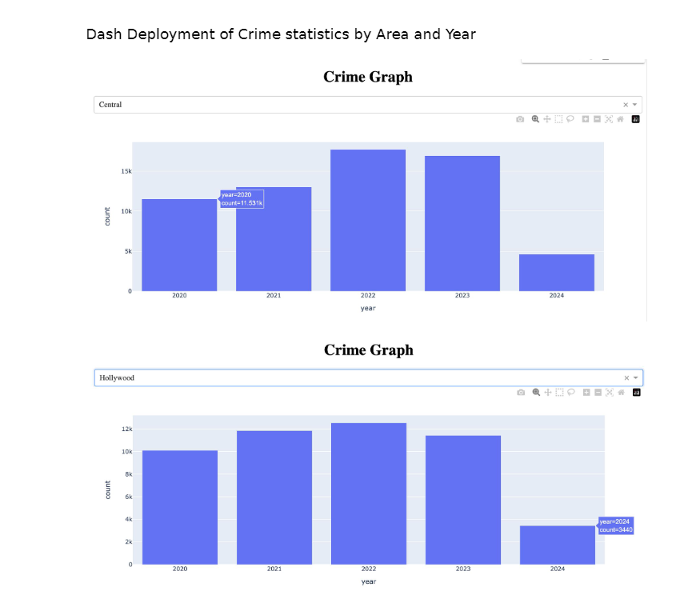
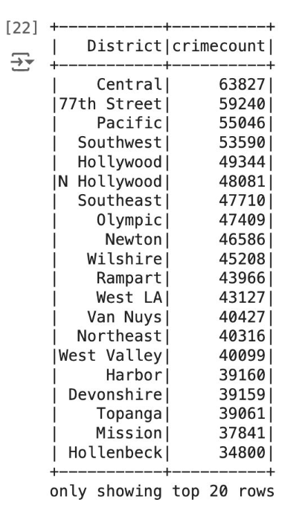
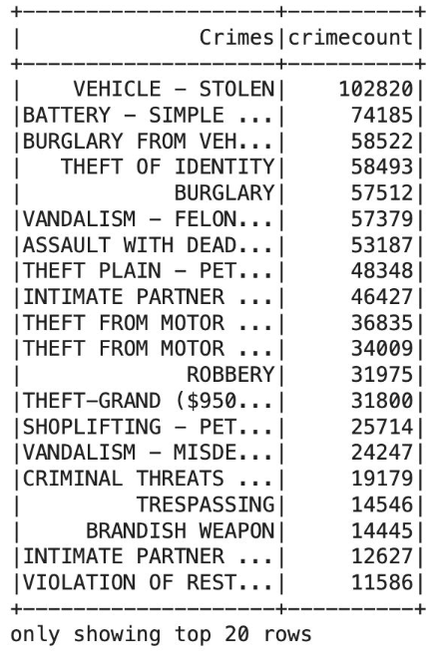
Data Analysis – Top crime area and crimes
Leveraging Spark allowed us to fly with the speed of angels in identifying the top crimes and crime areas in Los Angeles. If you were driving your vehicle in Central in 2023, the angels couldn’t save you from theft.

Slide 13
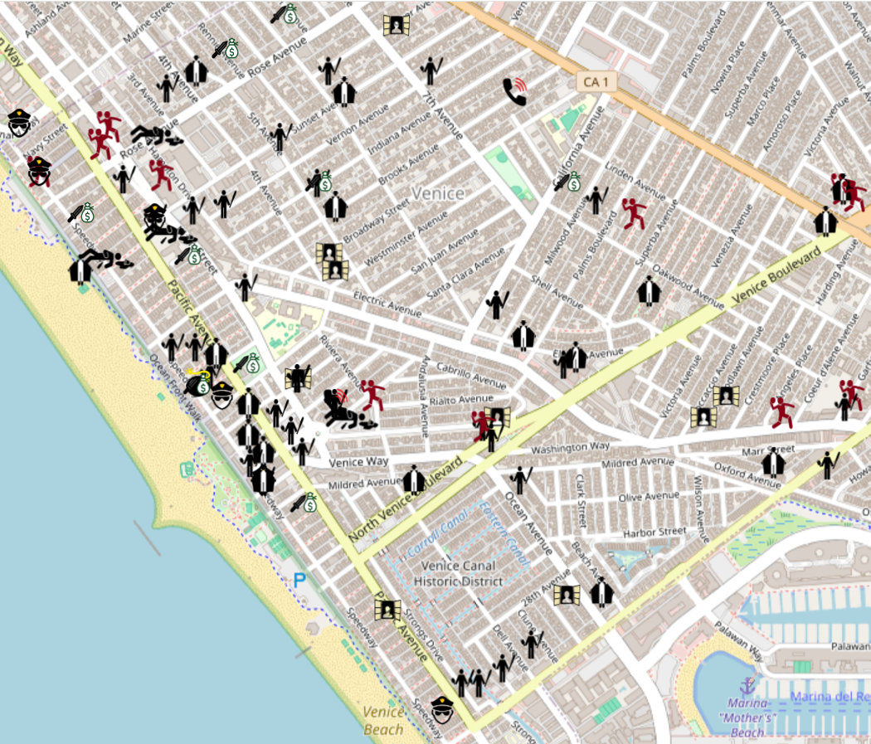
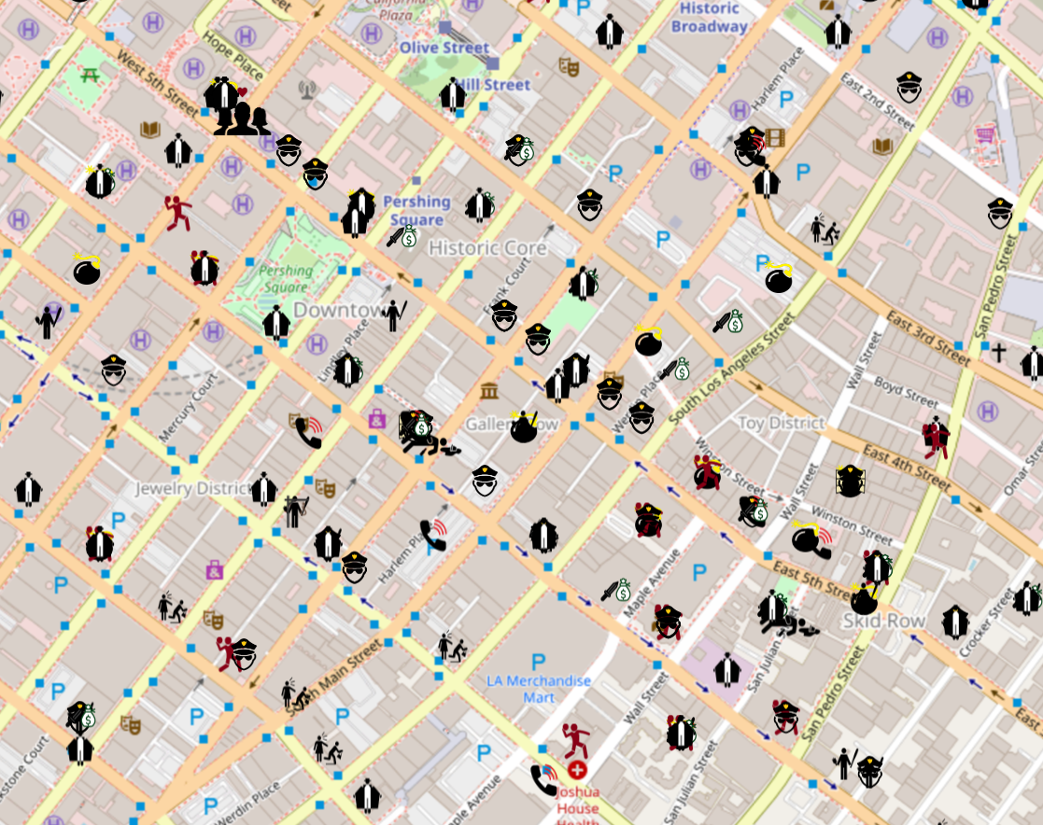
Data Analysis – Not-So-Angelic Appearances:
Some of the lesser known “Fallen Angels” can also tell interesting stories. Here we focus on outliers.
Available live at: https://petrick312.github.io/la_crime_map/
Notes:
*Millennials ages range from

Slide 14
The “Other” Side of LA Crime:
Partaking in too many Fallen Angel drinks may let you think you can fly
But falling asleep on Venice Beach after may leave you lighter in the pocket
You won’t hear any “Is your refrigerator running?” calls in Koreatown
Threatening phone calls and/or letters are more likely to occur and are no laughing matter
If you’re looking for a new not so “angelic” career, take yourself down to South Figueroa Street
Pimping and pandering can be found at it’s peak along this road between W 59th and W 106th Streets
Men and women in blue should be on the lookout in Central LA
Assault with a deadly weapon on a Police Officer is most prevalent in this area
Disturbing the Peace and Inciting a Riot seems more commonly seen in Wilshire than a “Pretty Woman”
Stars aren’t all tourists will see in Hollywood
Visitors should be leery of “lewd” walkers…possibly in trench coats
Notes:
*Millennials ages range from

Slide 15
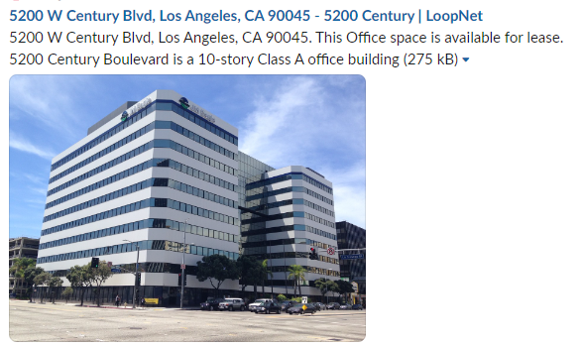
Revelations - Lynching
Lynching as a category of crime stood out due to specificity and history
33 Incidents in the period of time covered
10/15/2020 – seven individuals involved in a lynching event, after the 10/14/2020 sit-in in Los Angeles (and other cities) to protest the murder of George Floyd on Figueroa Street
Anti-lynching bill supported by bipartisan majority was ended in 2018
Lynching was not a hate crime until 2022

Slide 16
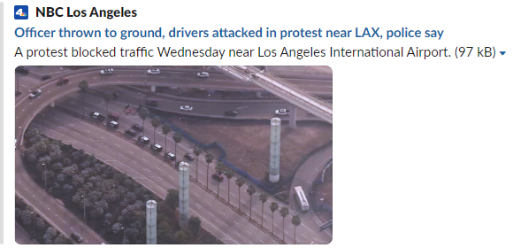
Revelations – inciting a riot
22 Incidents in the data
12/27/2023 had 19 Incidents of Inciting a Riot, all arrested during a protest that blocked traffic near Los Angeles International Airport
“Pretty Woman” made Wilshire Boulevard seem angelic, but according to our data, one would have better luck inciting a riot than buying designer clothes

Slide 17

Revelations – VULNERABLE angels
Although Millennials have the highest percentage of crime victims, it is noteworthy that Gen Alpha has the second highest percentage. We believe this is due to the fact that they are a younger generation and are more vulnerable to crime
Gen A is 40% of the size of the Millennials but they have almost the same chance as being the victim of a crime
Those crimes tended to be more personal in nature like kidnapping, neglect, incest, endangerment, child abuse and pornography
Notes:
Generation Age Ranges
Gen Alpha 0 - 11 years , Gen Z 12 - 27 years, Millennials 28 - 43 years, Gen X 44 - 59 years, Baby Boomers 60 - 78 years, Silent Generation : 79 - 96 years

Slide 18
Conclusions – the heavens opened
Machine learning pointed us into the trends to focus on, namely area was quite possibly the most important feature in predicting the likelihood of being a victim of crime
Gender and age of the victims also seemed to carry weight as well
Vehicle Theft was overwhelmingly the highest incidence of occurrences
Granular analysis provided the insights for the data points of interest, a.k.a. “Revelations”
Figueroa Street demonstrated the least angelic in behaviors around these statistics, because it seems to be a hotbed for pimping, pandering, and lynching
Falling asleep in Venice may result in being drunk rolled
The City of Angels could tarnish a few halos because of violent crime rates in lower-income areas and rates of theft in higher-income areas

Slide 19
Thank you to *our* angels!
We want to send a huge THANK YOU to all those that Lifted us Higher and Higher to contribute in the success of our We-R-No Angels team:
Raina Gustafson - Thank you for your guidance and knowledge. For caring about both what you’re teaching and how you teach it.
Jeanette Luu & Enkhsanaa Sommers - Thank you for your support in facilitating such a positive learning environment!
Sheri Rosalia - You’ve been an Angel on our side throughout this journey. Thank you for your time, your enthusiasm, your knowledge and most of all, your encouragement.

